Slide 1
Theory of Automata 2PDA
Week 13

Slide 2
Contents
Two Stack PDA
Just another TM “2PDA = TM”
Simulate a TM over PM
nPDA = TM

Slide 3
2PDA or Two Stack PDA
Let us define a two-stack pushdown automaton
as follows
M = (K, Σ, Γ, Δ, s, F)
K is a finite set of states,
Σ is an alphabet (the input symbols),
Γ is an alphabet (the stack symbols),
s ∈ K is the start state,
F ⊆ K is the set of final states, and
Finite set of transition from one state to another state

Slide 4
2PDA
As we have two stacks for storage purpose, so change the name of POP and PUSH stack accordingly.
POP₁ will pop from the first stack
POP₂ will pop from the second stack
PUSH₁ will push into first stack
PUSH₂ will push into second stack

Slide 5
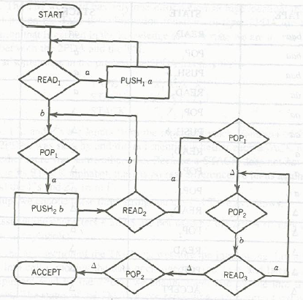
Guess the Language
a^{n}b^{n}a^{n}

Slide 6
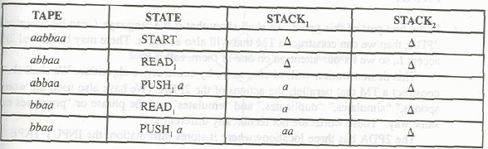
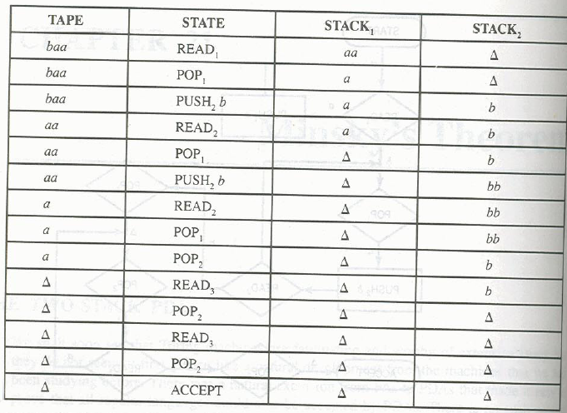
\
Run
aabbaa

Slide 7
Just another TM “2PDA = TM”
Minsky’s Theorem
Theorem:
Any language accepted by a 2PDA can be accepted by some TM and any language accepted by a TM can also accepted by 2PDA.
Proof :
2PDA has 3 locations for storage
Stack1
Stack2
Input Tape

Slide 8
2PDA = TM
Step-1 assume # and $ are not used by 2PDA
Step-2 Divide TM into three parts
Insert ∆ in cell i.
First Part
contains input string
We change each letter into ∆ as the letters are read by the 2PDA.
Put # at the end of input strings as end marker
Second Part
Contains the Stack1 of the 2PDA
$ is placed as the end of stack1 contents over the input tape
Third Part
Contains the Stack2 of the 2PDA
will indicating the end of stack2 contents

Slide 9
Read simulation
TAPE x₁, x₂ x₃ x₄
STACK₁ Y₁ Y₂ Y₃ Y₄ Y₅
STACK₂ Z₁, Z₂
The input tape will be
⁭
After simulating any action of 2PDA TAPE HEAD will return to # before beginning its next operation
∆ | ∆ | ∆ | X₃ | X₄ | # | ….

Slide 10

After putting input string and two stack over the input TAPE of Turing machine, the Input TAPE will be as under

Slide 11
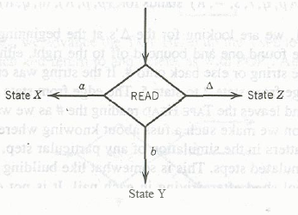
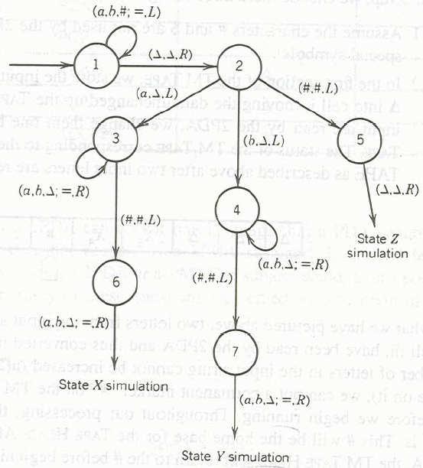
(a,b,#;=,L)
Above statement equals
(a,a,L)
(b,b,L)
(#,#,L)

Slide 12
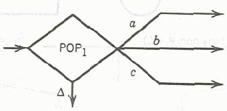
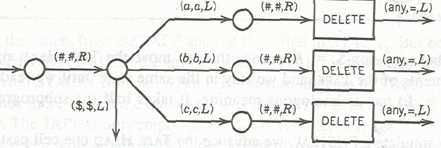
Simulate POP₁ instruction
Becomes

Slide 13
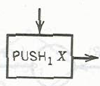

Simulating Push₁
Becomes

Slide 14
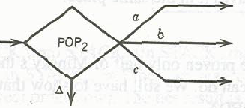
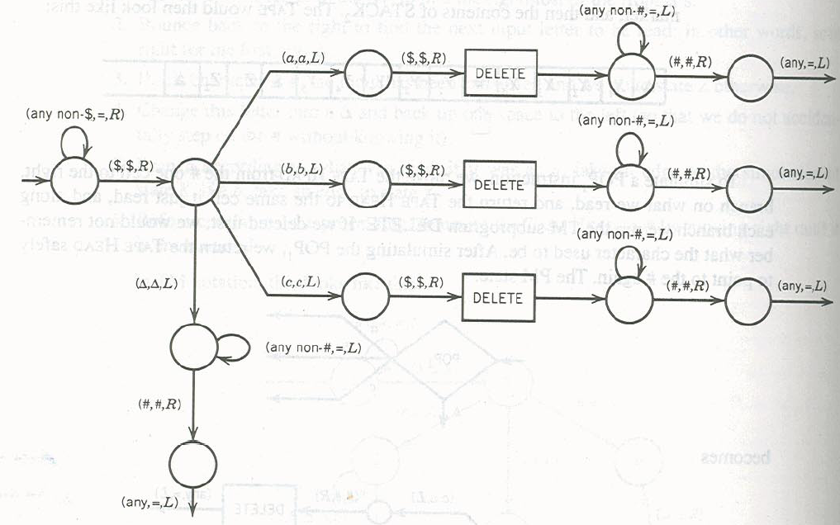
Simulating POP₂
Becomes
14

Slide 15

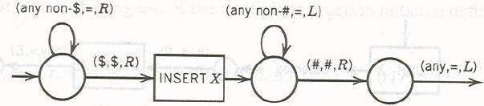
Simulating Push₂
Becomes

Slide 16
Simulate a TM over PM
This part will not be proved directly
We will make a 2PDA for PM and as we have already proved that PM=TM,
So indirectly it is proven that 2PDA = TM
We will do the above step for convenience as constructing 2PDA for PM is easier as compared to constructing 2PDA for TM.

Slide 17
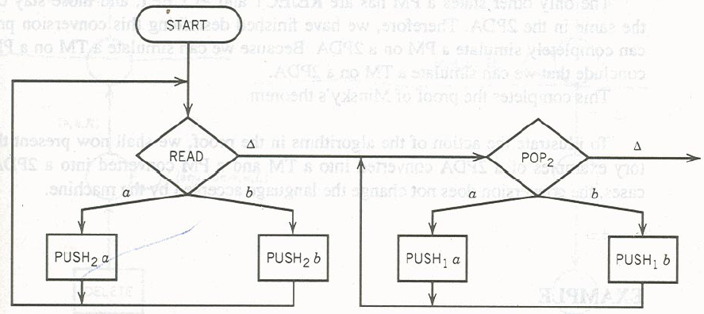
2PDA = PM
PM starts with input string already in the STORE, so we will store the input strings over the stack1 as follows

Slide 18
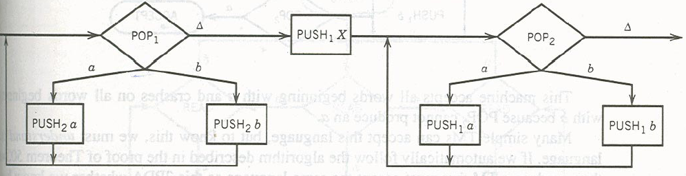
Simulating a ADD of PM
ADD of PM will add to right of string while push of 2PDA adds to left of the string.

Slide 19
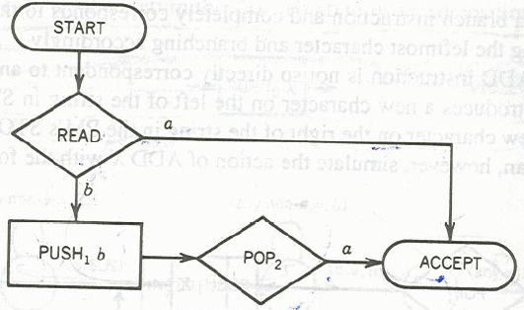
Construct a PM for following

Slide 20
nPDA = TM
Theorem 51
Any language accepted by a PDA with n STACKS
(where n is 2 or more), called an nPDA, can also
be accepted by some TM.
In power nPDA = TM

Slide 21
Theorem 51: PROOF
Suppose we have 3PDA (i.e. PDA with 3 stacks)
And the status is
TAPE w₁w₂w₃w₄
STACK₁ X₁X₂
STACK₂ Y₁ Y₂ Y₃ Y₄ Y₅
STACK₃ Z₁, Z₂Z₃
The input tape will be
⁭
∆ | ∆ | ∆ | w₁w₂w₃w₄ | #₁ | x₁x₂ | #₂ | y₁y₂y₃y₄y₅ | #₂ | z₁z₂ | ∆ | …

Slide 22
nPDA = TM
Remaining proof is the same as for 2PDA. So
nPDA = TM for n ≤ 2
Symbolically we can represent the power comparison of our various mathematical models of machines as follows.
FA = TG = NFA < DPDA < NPDA < 2PDA = nPDA = PM = TM

Slide 23
Problems
2 EQUAL
3 EQUAL
MOREa
DoubleWord
a^{n!}
a^{2^n} hint (chop the input into half at every iteration)
Delete SubProgram

Slide 24
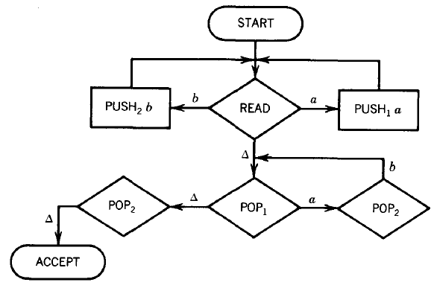
EQUAL EQUAL

Slide 25
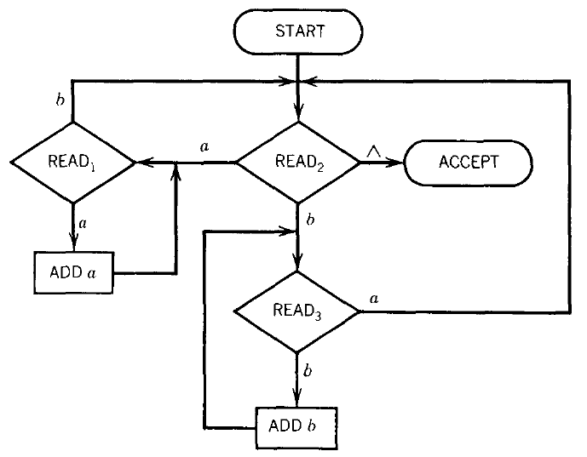
PM-EQUAL EQUAL

Slide 26
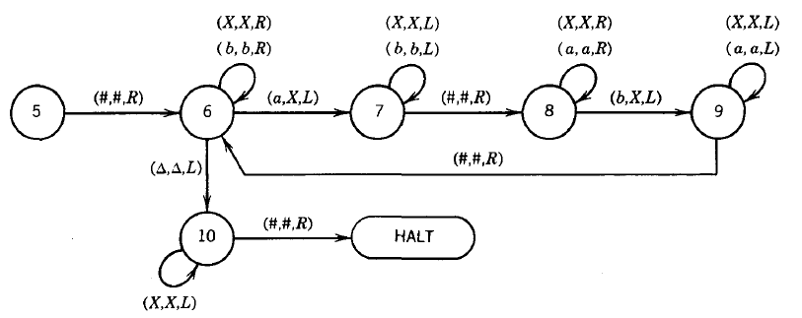
TM-EQUAL EQUAL

Slide 27
Build a TM
Language: DOUBLEWORD, the set of all words of the form ww where w is a nonnull string in {a,b}*. DOUBLEWORD = {aa bb aaaa abab baba bbbb aaaaaa aabaab . . }

Slide 28
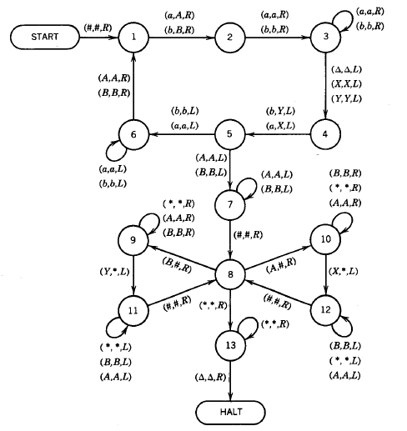
TM-DoubleWord
Build a PM-2PDA-3PDA for DoubleWord

Slide 29
Language: a^{n}b^{n}c^{n}d^{n}
Design a PM
Design a 2PDA
Design a 3PDA
Dec 3, 2012

Slide 30
Language: 3EQUAL
Let us define the language 3EQUAL over the alphabet {a,b,c} as all strings that have as many total a's as total b's as total c's.
3EQUAL = {abc acb bac bca cab cba aabbcc
aabcbc . . . }
Design a TM
Design a PM
Design a 2PDA
Design a 3PDA
Dec 3, 2012
Dec 3, 2012

